Slide 1
Northeast Factory Direct
Adrian Grimm
WDD229
Advanced Wed Design
2/16/2020

Slide 2
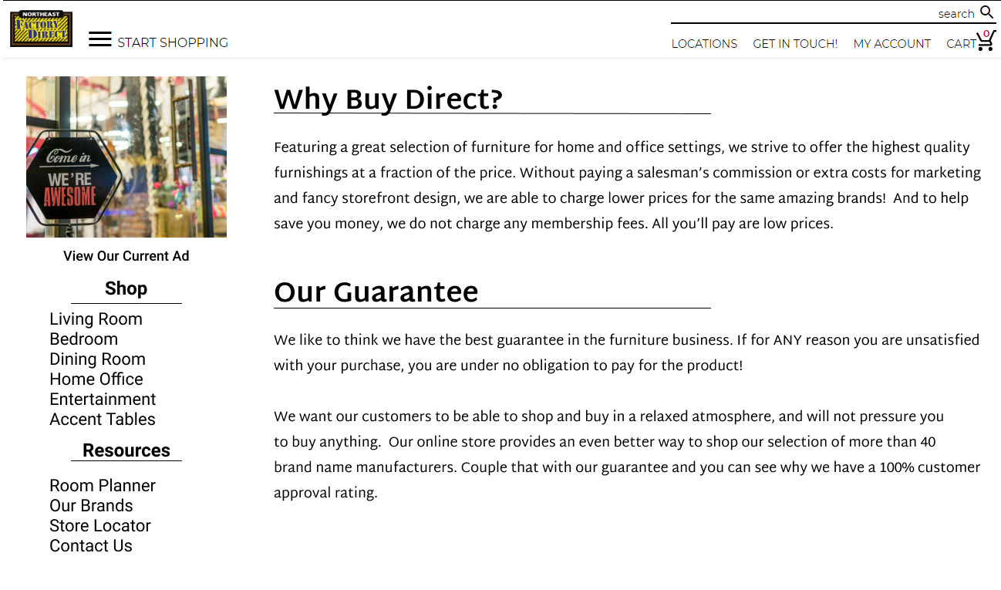

Slide 3

Why buy Direct?
Featuring a great selection of furniture for home and office settings, we strive to offer the highest quality furnishings at a fraction of the price. Without paying a salesman’s commission or extra costs for marketing and fancy storefront design, we are able to charge lower prices for the same amazing brands! And to help save you money, we do not charge any membership fees. All you’ll pay are low prices.

Slide 4
Our Guarantee
We like to think we have the best guarantee in the furniture business. If for ANY reason you are unsatisfied with your purchase, you are under no obligation to pay for the product! We want our customers to be able to shop and buy in a relaxed atmosphere, and will not pressure you to buy anything. Our online store provides an even better way to shop our selection of more than 40 brand name manufacturers. Couple that with our guarantee and you can see why we have a 100% customer approval rating.

